Slide 1
The Psychiatrist (Real-Time Sentiment Analysis of tweets on Twitter for Identifying People with Suicidal Tendencies with AI)
Group# 46
Ammara Khan
FA17-BSCS-003/C/2017-2021/BSCS
Zubair Mustafa
FA17-BSCS-081/C/2017-2021/BSCS
Supervisor
Jawad Hassan
Department of Computer Science
Lahore Garrison University, Lahore

Slide 2
Project Introduction
For first responders (Law Enforcement Agencies/Government Officials/Health Officers) incase of any suicide attempt.
“The Psychiatrist” is a Web-based application project through which the Twitter users who display signs of being suicidal are identified.
Primary target of this application are the first responders.
The secondary targets are the researchers and student to make the application more efficient and accurate.
The admin provides access to users. The authorized users after logging into the system can view cases and modify them as required.

Slide 3
Problem Description
According to World Health Organization, over 800,000 individuals commit themselves each year.
Suicides among teenagers and young adults continue to be a major issue.
For children, adolescents, and young people aged 15 to 24, suicide is the second highest cause of mortality.
Many people tweet which shows that they are in stress or depression which leads to suicide.
So, by this project, we hope to provide a means or a solution to control the suicide rate by identifying such people so that they can get required medical attention.

Slide 4
Project Objective/Scope
To save time and life.
To help control high suicidal rate.
To provide first responders a solution in identifying suicidal people and provide them required medical attention.
To keep track of cases as they progress.
15/9/2021

Slide 5
Tools/Technology/Technique
Python 3.8 (for backend development).
Twitter API (to retrieve real-time tweets).
Sublime Text/Visual Studio Code (for project Development).
Web Development (HTML, CSS, JavaScript for frontend development).
Artificial Intelligence/Machine Learning (for sentiment prediction).

Slide 6
Project Milestones/Deliverables
Approval for Twitter Development account.
Selection of suitable Algorithm.
Development of Backend application.
Development of Frontend Application.

Slide 7
Project Method
The application takes tweets from twitter through its API.
Applies sentiment analysis on the tweets for prediction.
It either predicts 0 for Potentially Suicidal Post or 1 for Non-Suicidal Post.
Suicidal Post is saved in the database including its additional information. Non-Suicidal Posts are discarded.
The web-based frontend displays the tweet, user’s profile link, tweet link and status after retrieving data from the database.
Provides additional modification functions like Update Status to Delete Case.

Slide 8
Conclusion
Identifying user profiles who are suicidal or show the signs of being suicidal was focused on in this project.
A detection model was developed based on a collection of certain keywords. To identify Twitter accounts, linguistic and emotional features are used.
Machine Learning techniques (mostly deep learning) were applied to detect suicidal behaviour using classifiers. Furthermore, a Python-based system was employed to detect suicidal thoughts.
We will to improve the outcomes of the suicidal profile identification in the future by defining the degree of suicidality more preciselyy, add more features like sending Direct Messages (DMs) to the identified users’ followers about the user being identified as suicidal.

Slide 9
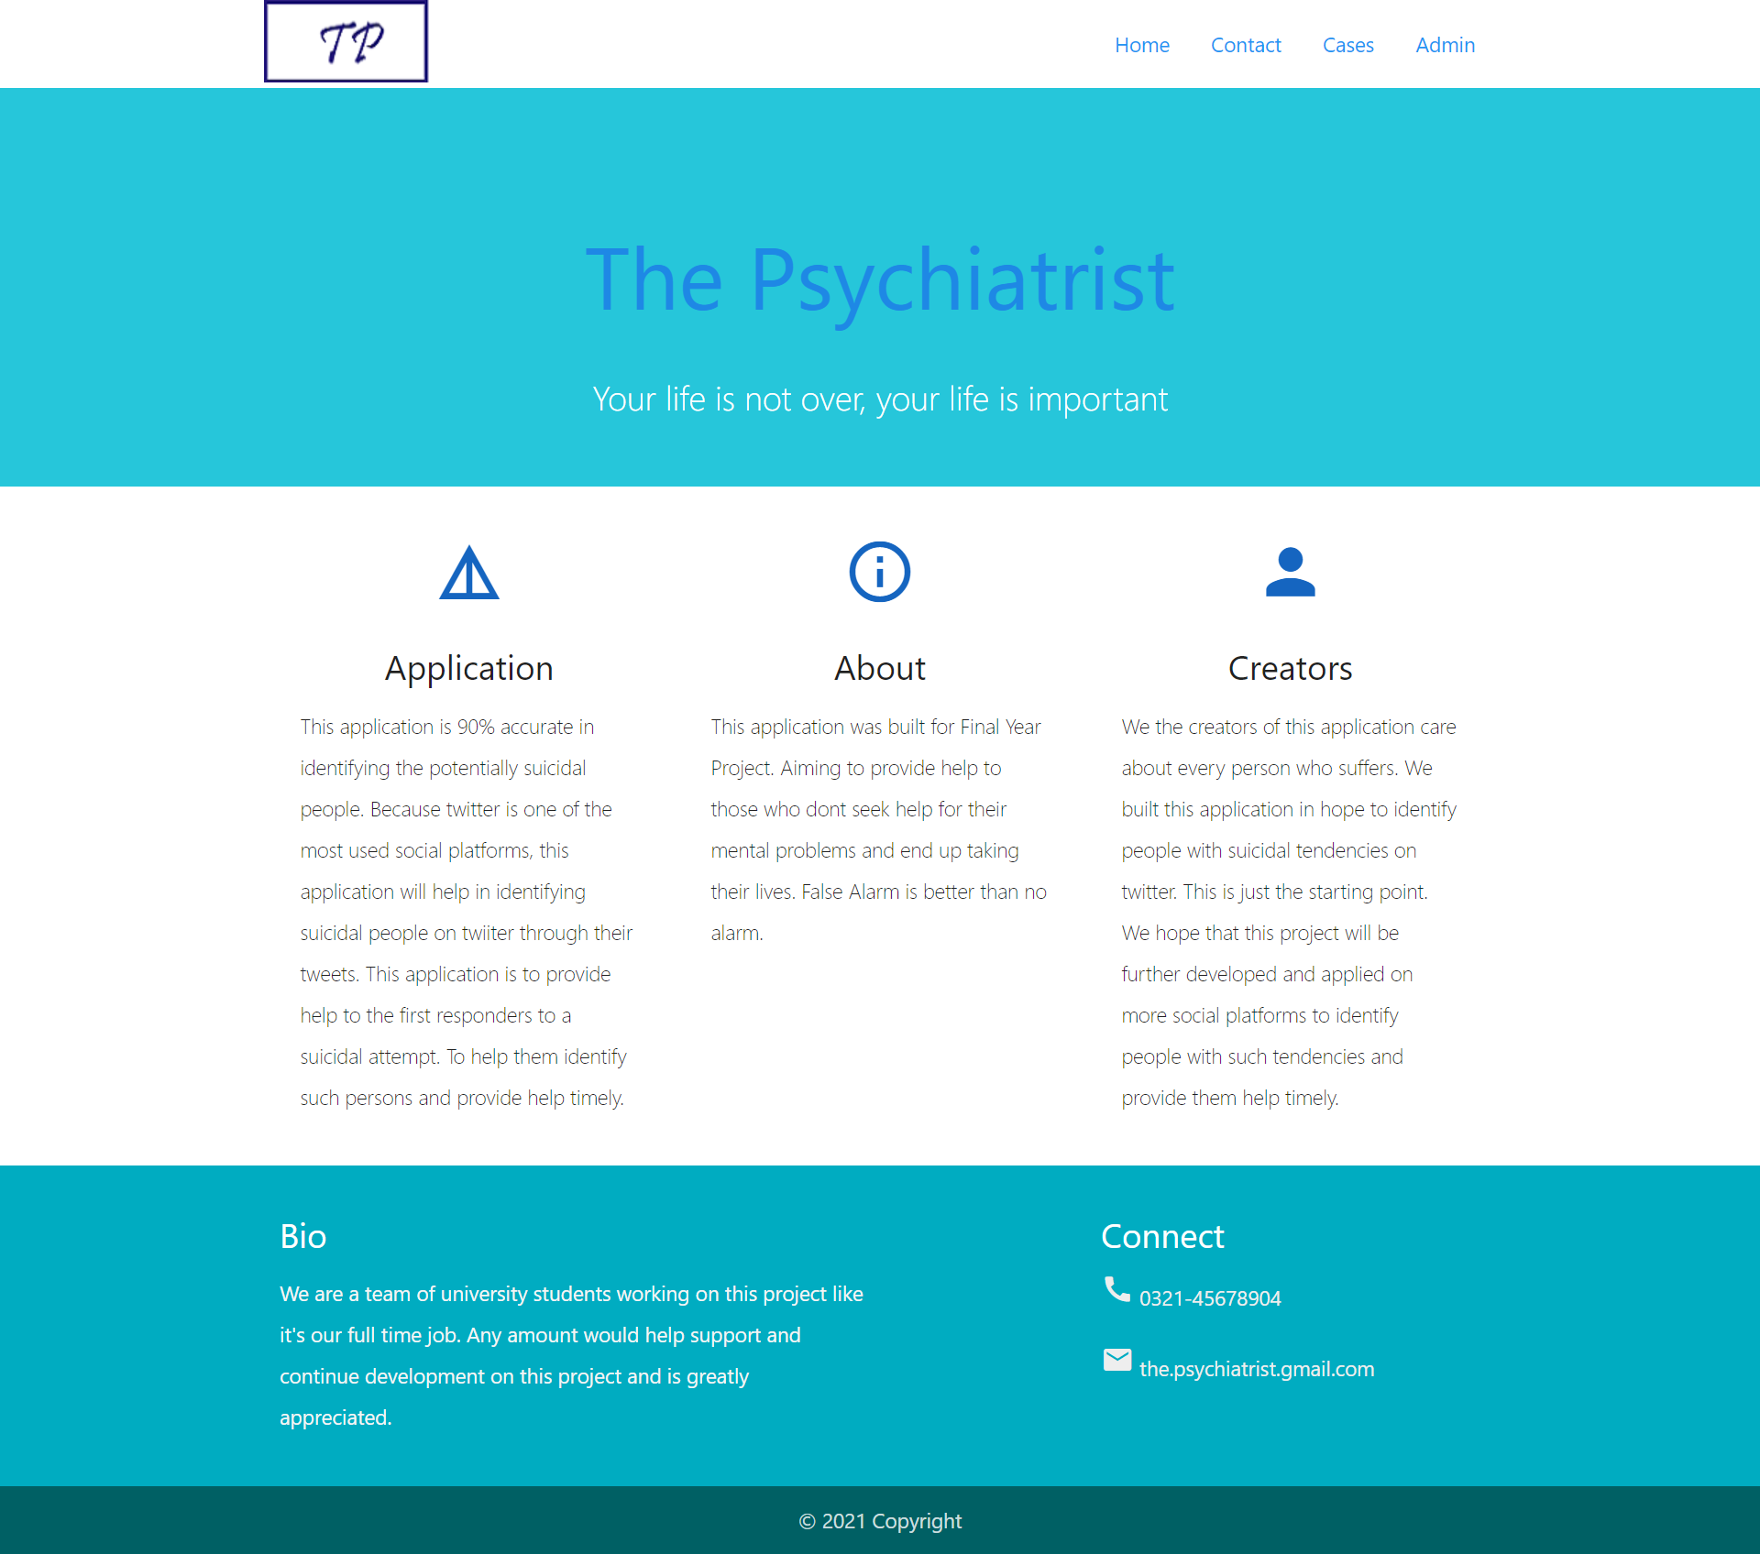
Result
Home Page

Slide 10
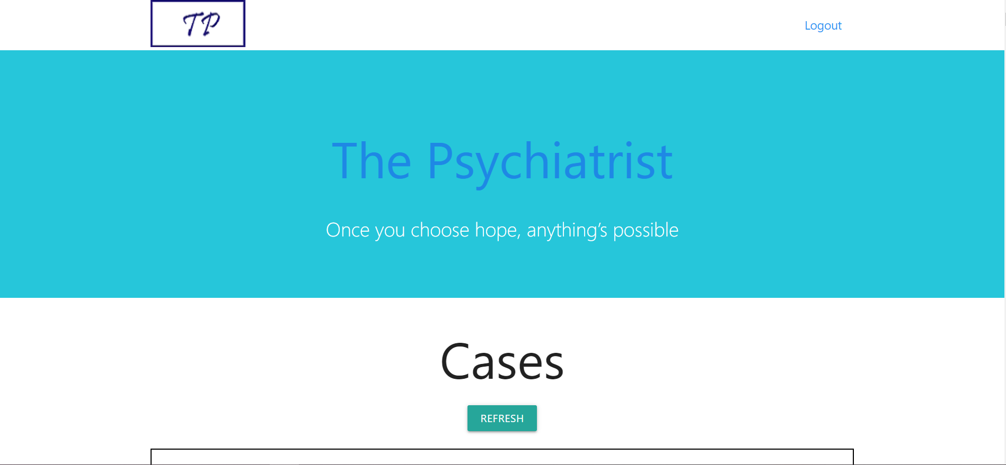
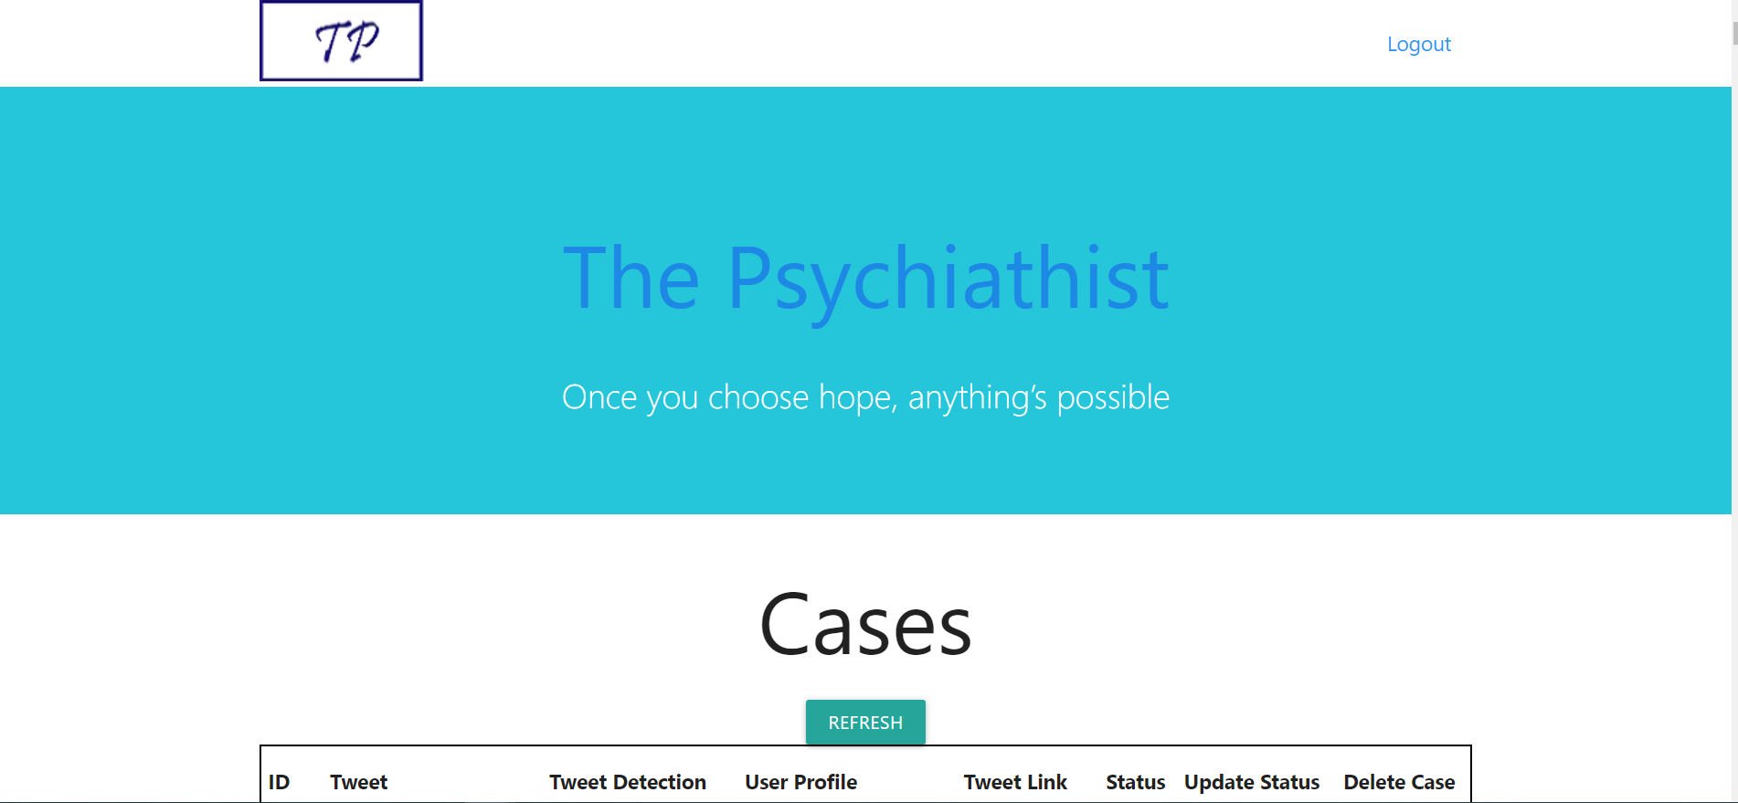
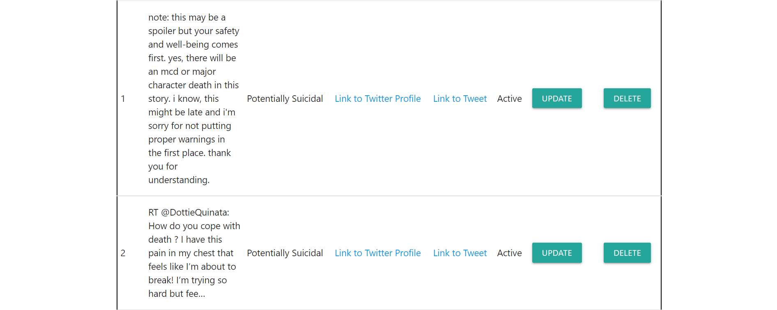
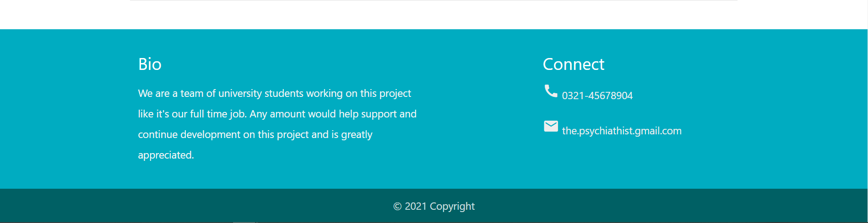
Cases Page

Slide 11
References
World Health Organization. National Suicide Prevention Strategies: Progress, Examples and Indicators; World Health Organization: Geneva, Switzerland, 2018. (Article)
https://www.geeksforgeeks.org/software-engineering-architectural-design/
Michael Mesfin Tadesse, “Detection of Suicide Ideation in Social Media Forums Using Deep Learning” (Article)

Slide 12
THANK YOU

